Slide 1
Ascend Pro Hackathon Assessment – Prediction the probability of stroke
-By Nirmal Tom

Slide 2
PROBLEM STATEMENT OVERVIEW
Predicting the probability of stroke occurrence of a dataset which has several health, demographic and lifestyle details about its patients.
This includes details such as age and gender, along with several health parameters and lifestyle related variables

Slide 3
Problem Statement Overview
The probability of stroke can increase with
Age
Blood Pressure
Previous Heart attacks
High cholesterol
Diabetes history
Smoking may cause stroke.
HYPOTHESIS

Slide 4
INFERENCES FROM DATASET
Patient Characteristics:
Age : 19 - 65 yrs
BMI : 20 – 37
Avg Glucose level : 61 -148
Gender : 60% - Females; 40% - Males.
Marital Status : 64% - Married
Hypertension : 10%
Heart Disease : 5%
Work Type : 57.2% - Private firms
12.5% - Government firms
Patients in Rural and Urban areas are equally distributed

Slide 5
MISSING DATA AND ITS RELEVANCE
13292 values on smoking status is missing!!
1462 values on BMI are missing!!
Will this impact the probability score?

Slide 6
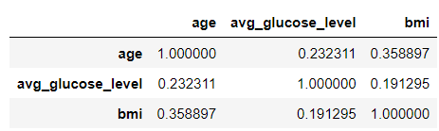
CORRELATION BETWEEN AGE, BMI AND GLUCOSE LEVELS
Age and BMI values are correlated

Slide 7
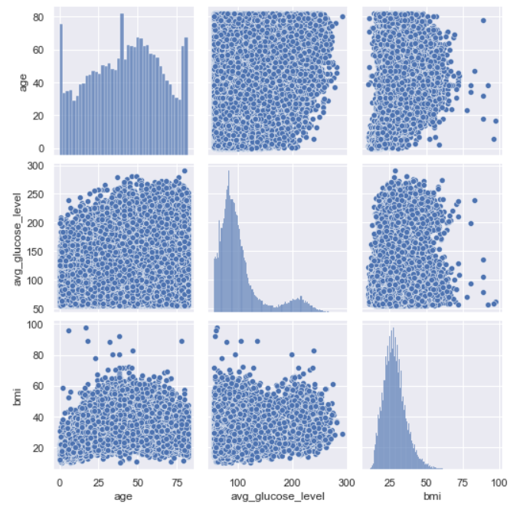
CORRELATION BETWEEN AGE, BMI AND GLUCOSE LEVELS
Average glucose level is high with old people
BMI >60 have low average glucose.

Slide 8
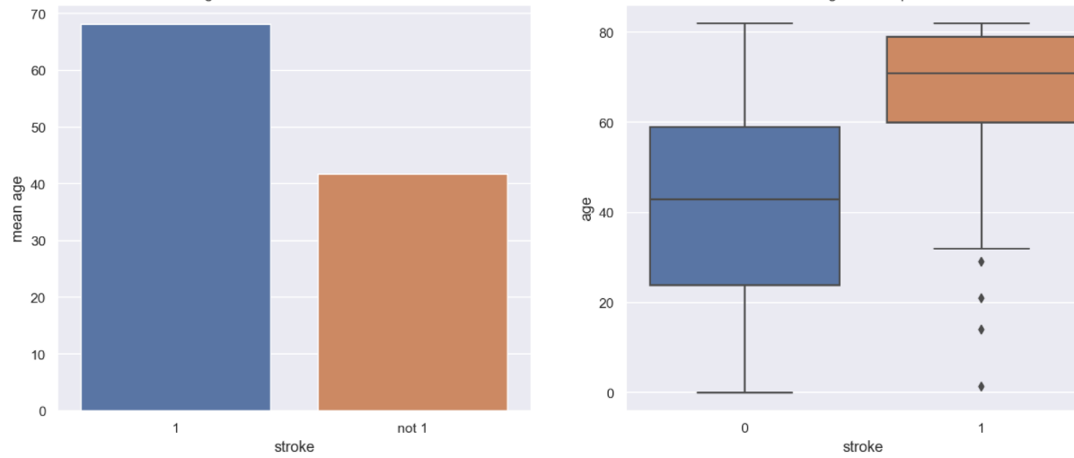
DOES AGE PLAY A ROLE IN STROKE OCCURRENCE? -FROM BIVARIATE ANALYSIS
Mean(Age) - 44 ;Mean(Age)_HavingStroke – 68
Mean age of patients who got stroke and patients who did not got stroke are significantly different

Slide 9
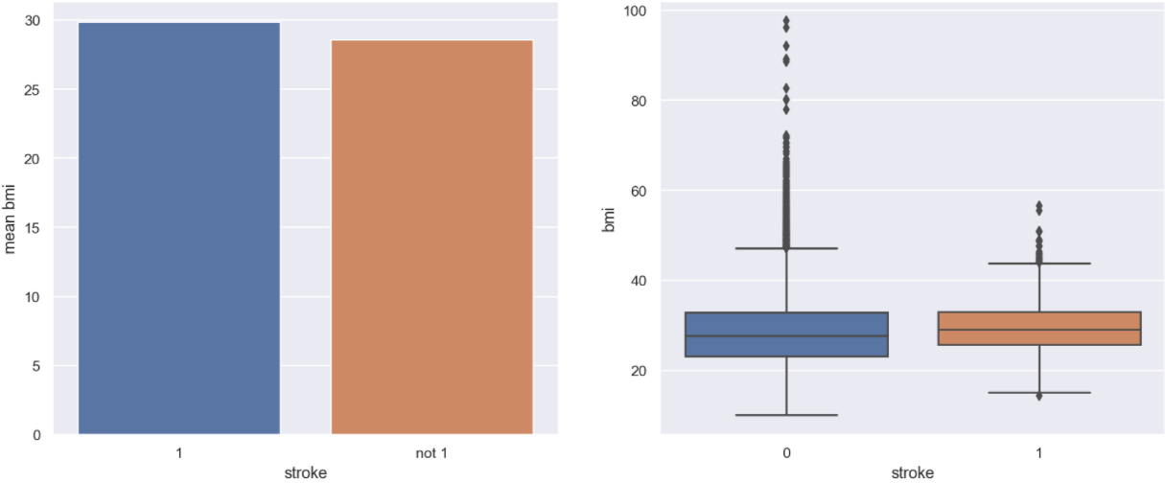
DOES BMI PLAY A ROLE IN STROKE OCCURRENCE? -FROM BIVARIATE ANALYSIS
Mean(BMI) - 28 ;Mean(BMI)_HavingStroke – 29
Mean Bmi of patients who got stroke and patients who didn't got stroke are not significant

Slide 10
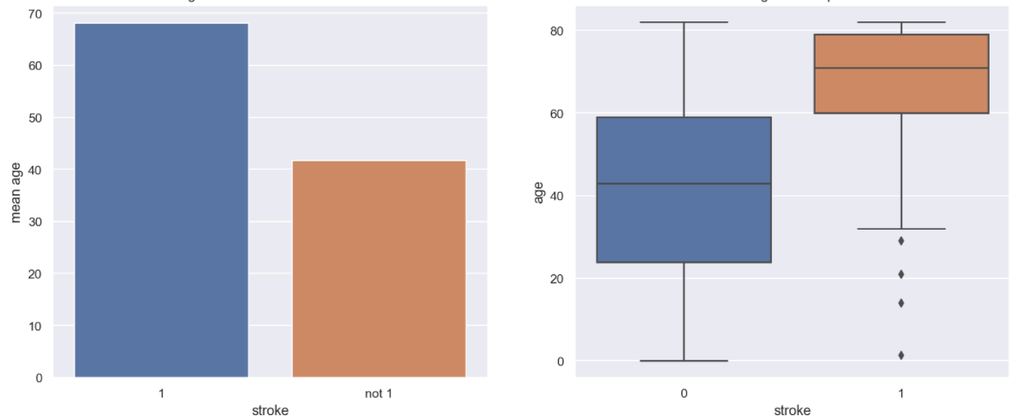
DOES GLUCOSE LEVEL PLAY A ROLE IN STROKE OCCURRENCE? -FROM BIVARIATE ANALYSIS
Mean(AvgGlucoseLevel) - 104 Mean(AvgGlucoseLevel)_HavingStroke – 129
Mean avg_glucose_level of patients who got stroke and patients who didn't got stroke are significant

Slide 11
OTHER INFERENCES FROM EDA -FROM BIVARIATE ANALYSIS
Attributes that affected Stroke:
Marital Status - Married people are more prone to stroke
Heart Disease - Patients with heart disease more likely to have stroke
Hypertension - Patients with Hypertension more likely to have stroke
Work Type - Patients working in private sector & self employed more likely to have stroke
Patients with smoking history more likely to have stroke
Attributes that did not affect Stroke:
Residence Type –It has no significant effect on the stroke
Note: Missing values in smoking status have significantly different stroke rate than the rest of the data

Slide 12
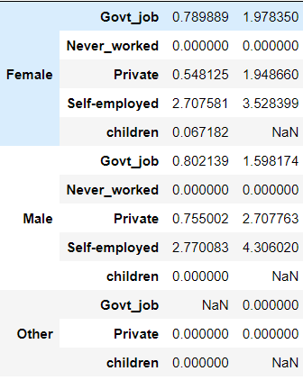
HIGHEST NO. OF STROKE PATIENTS- SELF EMPLOYED MEN?? -FROM MULTIVARIATE ANALYSIS
2.7% Male & Female self employed are having stroke
4.3% Married male - self employed are having stroke

Slide 13
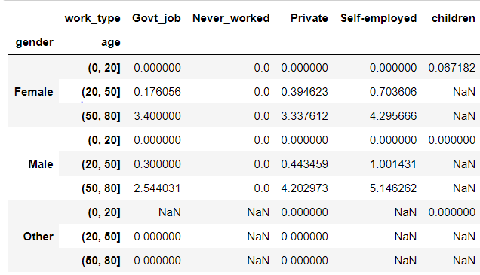
HIGHEST NO. OF STROKE PATIENTS- 50 YEARS AND ABOVE!! -FROM MULTIVARIATE ANALYSIS
Male patients that are self employed of age group 50-80
Female patients that are self employed/Govt job of age group 50-80

Slide 14
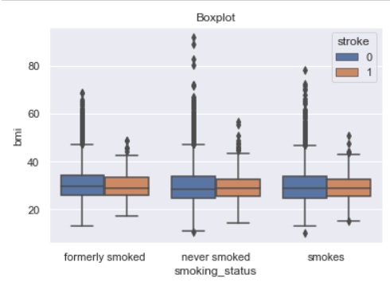
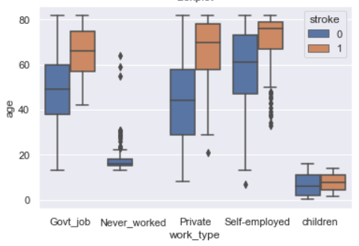
HIGHEST NO. OF STROKE PATIENTS- OTHER INFERENCES -FROM MULTIVARIATE ANALYSIS
More the Glucose Levels, more the number of stroke for Females with Govt job
Stroke chance increase with 50-80 age group
BMI and smoke status did not affect the stroke rate

Slide 15
CONCLUSION
Probability of stroke occurrence based on the dataset, is as follows
Female candidates, in the age group of 50-80 years, and is also employed the probability of stroke occurrence is very high
Similarly, if the patient is male and is working for private organization or is self employed, and is also in the age cap of 50-80 years, the stroke expectancy is high
BMI and smoking habit do not seem to contribute much.

Slide 16
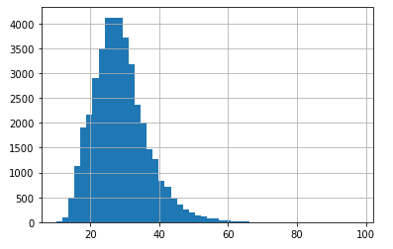
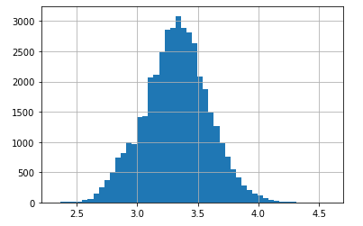
Data Pre-processing
Pre-processing
Feature transformation- BMI
Log transformation is applied for normalisation

Slide 17
Data Pre-processing
Pre-processing
Binning- AGE
Age is divided into 4 bins with
age between 0-19 as minor, 19- 30 as young, 30- 50 as elder & 50- 90 as old

Slide 18
Data Pre-processing
Missing Values Imputation
BMI
We can see that BMI is Missing Completely at Random
So we replace missing values in variable 'bmi' with its Median

Slide 19
Data Pre-processing
Missing Values Imputation
smoking_status
During EDA we understand that Missing values in smoking status have significantly different stroke rate than the rest of the data. There for we impute it with "unknown“ value.

Slide 20
Problem Statement Overview
We created 5 new features namely glulevel, Bpheart, Badcond, Oldmarriedself, FemaleGlucGovt based on conditions like
Glulevel where(age>50) & (avg_glucose_level>180 )
Bpheart where(hypertension == 1) & (heart_disease== 1)
Badcond where(BPheart == 1) & (glulevel == 1) & (smoking_status) = smoker, formerly smoked and unknown
Oldmarriedself where (ever_married ==Yes ) & (work_type = self and Pvt ) & (age> 49)
FemaleGlucGovt where(gender == Female) & (work_type = self and Pvt ) & (avg_glucose_level > 170)
Feature Engineering

Slide 21
Problem Statement Overview
Categorical encoding
Since people who've never smoked are probably less likely (on average) to have a stroke than those who did smoke in the past, which in turn are less likely to have a stroke than those who currently smoke, we can say there is some inherent order to these three categories. Unknown is assigned with 3 on the assumption that they are likely be smokers who hide information
Thus, it would be meaningful to encode them with 0, 1 ,2 & 3
Feature Encoding

Slide 22
Final Model Description along with parameters
We select features using
SelectKBest and F_Classif.
We used Logistic Regression with manual class weights since the dataset is imbalanced
Later tuned model by selecting variables with high coefficient > 0.3

Slide 23
Final Model Description along with parameters
Age, Hypertension, heart disease, Avg glucose level, age category are the features obtained
We again tuned this with Ridge Regression with C = 0.001

Slide 24
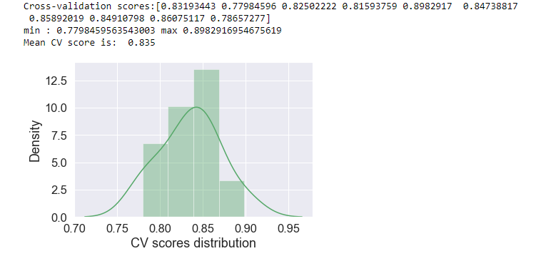
Internal Cross Validation/Other Validation Scores
We used StratifiedKFold with CV= 10 for cross validation and we got an roc_auc of
0.82562800

Slide 25
Thank you!!! -Nirmal TOM

